Slide 1



UNIT 8: Fit and healthy
Meals in Britain

Slide 2
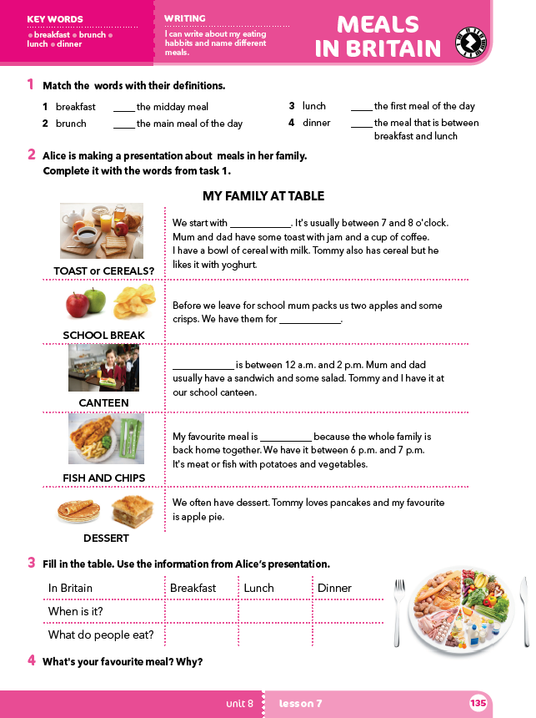
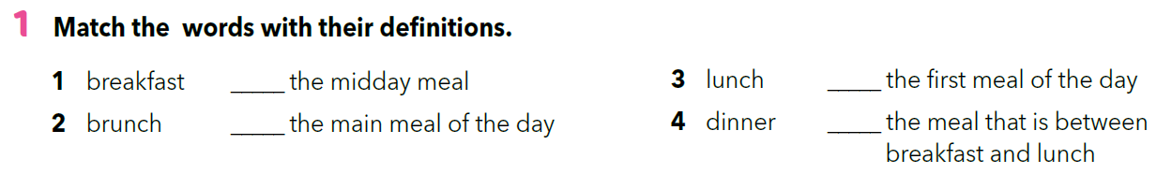
3
1
4
2

Slide 3
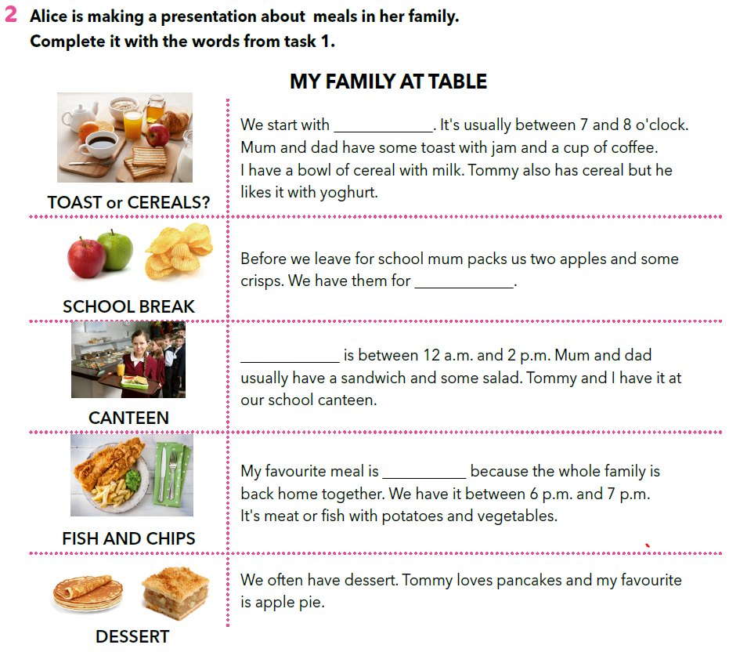
breakfast
brunch
Lunch
dinner

Slide 4
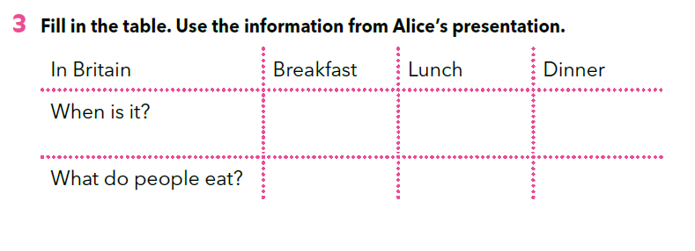

between 7 a.m. and 8 a.m.
between 12 p.m. and 8 p.m.
between 6 p.m. and 7 p.m.
toast with jam, coffee, cereal with milk or yoghurt
sandwich, salad
meat and fish with potatoes and vegetables

Slide 5
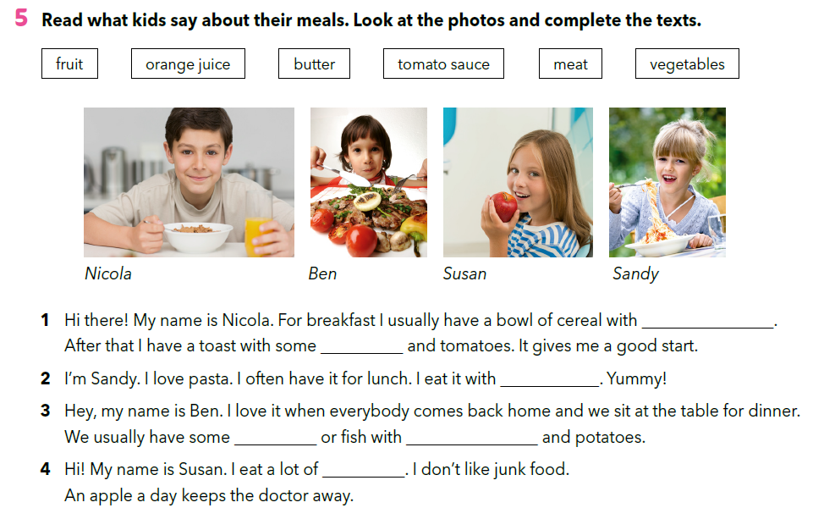
orange juice
butter
tomato sauce
meat
vegetables
fruit

Slide 6
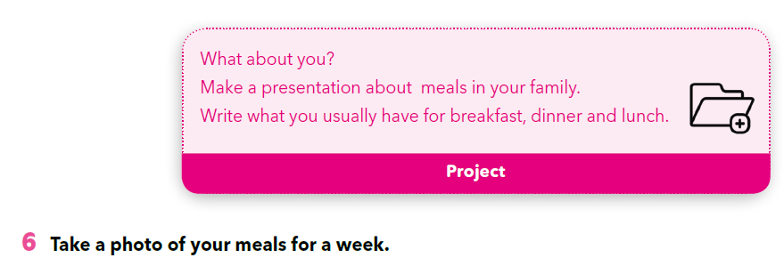
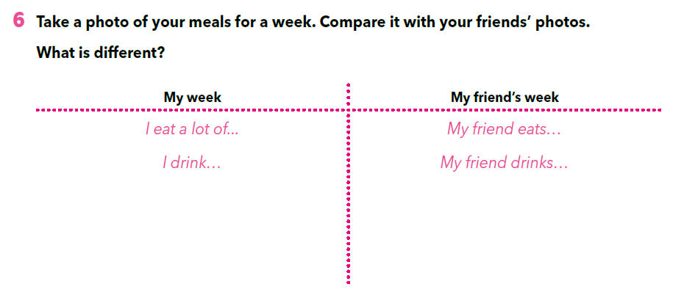

Slide 7

LET’S REVISE!
https://wordwall.net/play/261/699/466
LEARN MORE
https://www.e-sfera.hr/dodatni-digitalni-sadrzaji/2cffaefc-bc78-4c6e-aaa8-f6bcd94b76dc/
Food the American way

